Slide 1




Custom Equipment Package
D I S C || DIGITALISATION – INDUSTRIALISATION – STANDARDISATION - COLLABORATION
Gap:
No standardized approach within DISC to represent and model equipment/instrument packages on the P&ID.
Discussion:
This gap was examined in depth during the technical meetings, and a final approach was agreed upon at the DISC DEXPI workshop on 20.11.2025.
The conclusion: the package boundary shown on the P&ID represents an equipment or instrumentation package boundary. The content inside this boundary box may consist of one or more reference drawings and/or engineering elements.
The key functionality that the package boundary must represent is:
An identifier — typically the main package equipment name — which allows users to navigate to the detailed information for the package. It is expected that the intelligent engineering tool will support hyperlinking between this main identifier and all relevant sub-elements and/or documents.
Uniquely identifiable connection points — these define where the package boundary interfaces with existing facility systems or other “owned” parts of the plant. Connection points should display their identifier and, where relevant, their size. The intelligent engineering tool is also expected to store information associated with each connection point, including references to vendor or sub-vendor drawings that illustrate the “other side” of the interface.

Slide 2
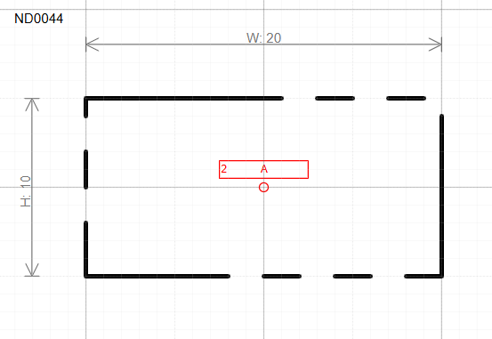
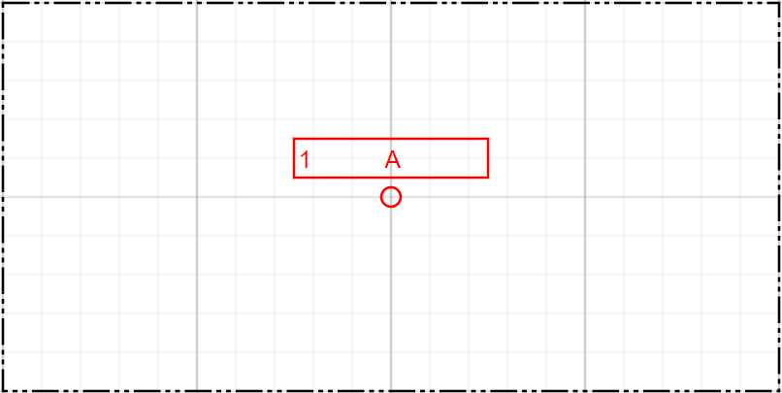
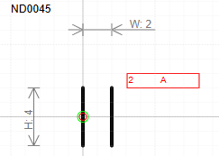
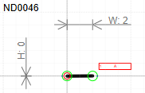
Custom Equipment Package
D I S C || DIGITALISATION – INDUSTRIALISATION – STANDARDISATION - COLLABORATION
New Symbols to support Custom Equipment Package and Connection Points:
To support the required solution 3 new symbols have been introduced as shown below with their mapping towards DEXPI 2.0.
Note: the class names identified below will be added as part of the DISC DEXPI profile.
RefID | Symbol | DISC DEXPI Class | Super Type | URI | Label
ND0044 |  | CustomEquipmentPackage | Equipment | https://data.posccaesar.org/rdl/RDS1300808591 | <ObjectDisplayName>
ND0045 |  | MechanicalJoint | Nozzle | https://data.posccaesar.org/rdl/RDS1300790941 | <ObjectDisplayName> <JointConnectionSize>
ND0046 |  | WeldedJoint | Nozzle | https://data.posccaesar.org/rdl/RDS16201431 | <ObjectDisplayName>

Slide 3
Custom Equipment Package
D I S C || DIGITALISATION – INDUSTRIALISATION – STANDARDISATION - COLLABORATION

